Slide 1

DSA Minor Project
Presentation on
HOSPITAL MANAGEMENT SYSTEM
Submitted by
ASHWANI(22BCS16719)
PRIYANSHU(22BCS16721)
MANISH(22BCS16720)
SUDHANSHU(22BCS16718)
Chandigarh University

Slide 2

Hospital management system

Slide 3

HOSPITAL MANAGEMENT SYSTEM
The Hospital Management System is a comprehensive software solution that streamlines the operations of healthcare organizations. It enables medical professionals to manage patient data, appointments, and billing with ease, while also providing real-time analytics to improve decision-making. With its intuitive interface and customizable features, the Hospital Management System is a valuable tool for hospitals, clinics, and other healthcare facilities. It ensures seamless communication between departments and enhances patient care by reducing administrative tasks.

Slide 4
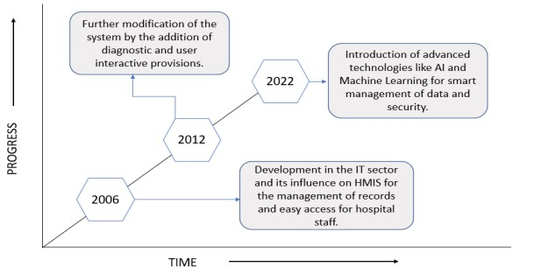
EVOLUTION AND PROSPECTS
The Graph depicts the timely rise of the use of HMIS in various health facilities and organizations and the improvement of the quality of the software with an increase in its demand.

Slide 5
Benefits of Hospital Management System
Improved Patient Care: Enhances the quality of patient care through quick access to accurate and up-to-date patient information. Enables healthcare providers to make informed decisions, leading to better diagnosis and treatment.
Enhanced Operational Efficiency: Streamlines administrative processes, reducing manual paperwork and saving time for staff. Reduces wait times, improves patient flow, and enhances overall operational productivity.
Reduced Errors and Improved Accuracy: Minimizes errors in patient records, prescriptions, billing, and scheduling through automation and standardization. Provides built-in checks and alerts for potential errors
Data-Driven Decision Making: Provides comprehensive reporting and analytics capabilities to derive insights from hospital data.
Enhanced Communication and Collaboration: Enables secure sharing of patient information, test results, and treatment plans. Improves interdisciplinary care coordination and enhances patient outcomes.

Slide 6
Challenges in Hospital Management
Billing and Payments
Patient Records
Hospital Details
Emergency Help
SORTING DATA

Slide 7

PROBLEM SOLUTION DISCUSSION…
Billing and Payments: The system can handle billing and payment processes, including generating invoices for medical services, tracking payments. It can integrate with financial systems to streamline the billing and reimbursement process.
SORTING DATA: The system can help the patients to get the more facilitated hospital to ensure that essential items are always available when needed.
Patient Records Management: The system can maintain comprehensive electronic patient records, including medical history, test results, prescribed medications, and treatment plans. It ensures that accurate and up-to-date patient information is easily accessible to authorized healthcare providers.

Slide 8
PROBLEM SOLUTION DISCUSSION…
Emergency Help: With the help of FAQs(Frequently Asked Questions) , it help the user to know about the immediate action to be taken after examining the symptoms.
Hospital Details: By providing data and insights on patient satisfaction, outcomes, compliance with quality measures, and efficient resource management, a Hospital Management System can contribute to the rating and assessment of hospitals.

Slide 9

FUTURISTIC SCOPE
Integration with Emerging Technologies:
HMS is likely to integrate with emerging technologies such as the Artificial Intelligence (AI), Machine Learning (ML), Internet of Things (IoT), and Big Data Analytics.
Mobile Applications and Patient Engagement:
Patients will be able to access their medical records, schedule appointments, receive reminders, view test results, and communicate with healthcare providers.
Data Security and Privacy:
Data Security and Privacy: As healthcare organizations adopt digital systems, ensuring data security and privacy becomes crucial.

Slide 10
Thank YOU

